Slide 1


CUSTOMER PERSONALITY ANALYSIS
-Mansi Rawal

Slide 2
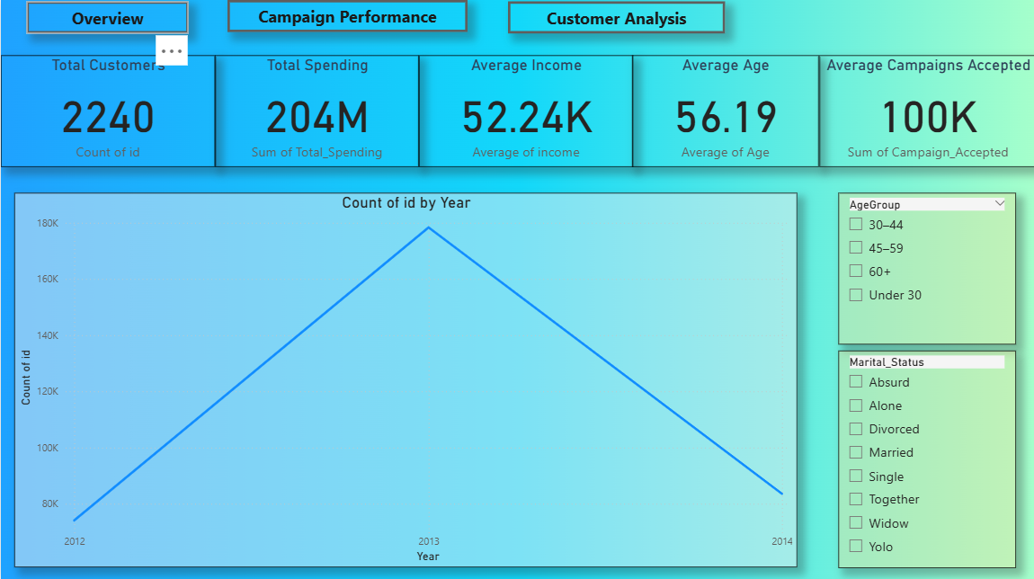
Overview:
Insights:
The business serves 2,240 customers, with 204M in total spending.
Customers are on average 56 years old, with good income levels (~52K).
Most customer sign-ups occurred around 2013.
Targeting middle-aged segments (45–59) can help scale.

Slide 3
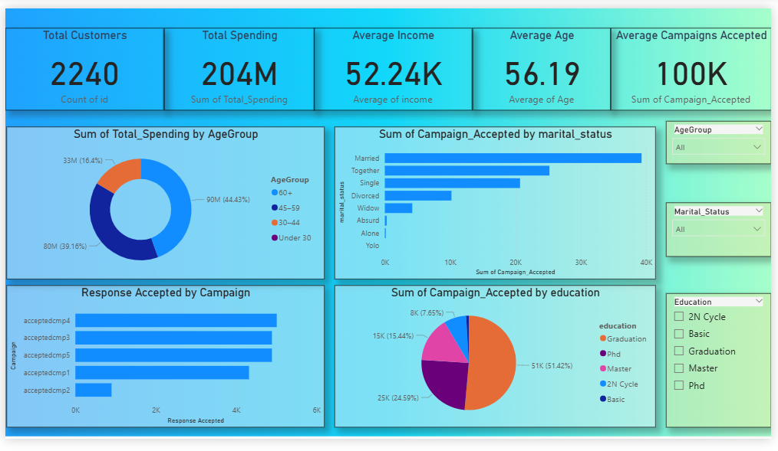
Campaign Performance :
💡 Insights:
Campaign 4 had the highest acceptance rates followed by Campaign 3 and Campaign 5 .
60+ aged and married customers accepted the most campaigns.
Customers with higher education levels engaged more in campaigns.
Campaign 2 had lowest engagement, indicating the need for redesign.

Slide 4
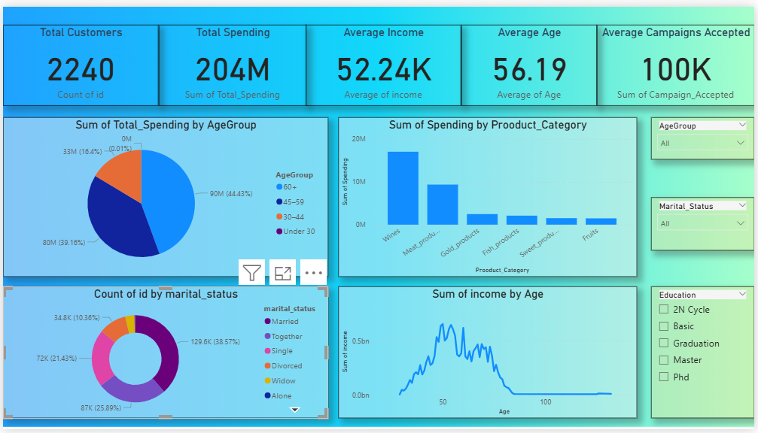
Customer Analysis :
💡 Insights:
Age group 60 + spends the most followed by 45-49 — this is your core target market.
Spending is highest on Wines and Meat Products — key product focus.
Married customers are the largest group — ideal for family-targeted marketing.
Spending rises with age until ~60, then declines.

Slide 5
Key Business Takeaways:
💡 Insights:
Focus campaigns on 60+ and middle-aged, married customers with higher income.
Improve or replace underperforming campaigns (like Campaign 2).
Prioritize product categories that drive high revenue.
Use dashboards interactively to filter by age/marital status for better targeting.

Slide 6


